Slide 1

Projects

Slide 2
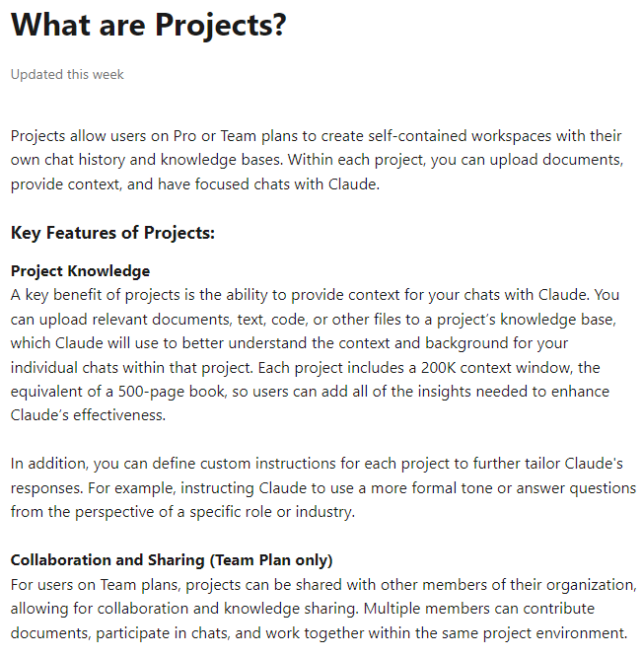
Projects
Notes:
https://support.anthropic.com/en/articles/9517075-what-are-projects
https://support.anthropic.com/en/articles/9519177-how-can-i-create-and-manage-projects

Slide 3
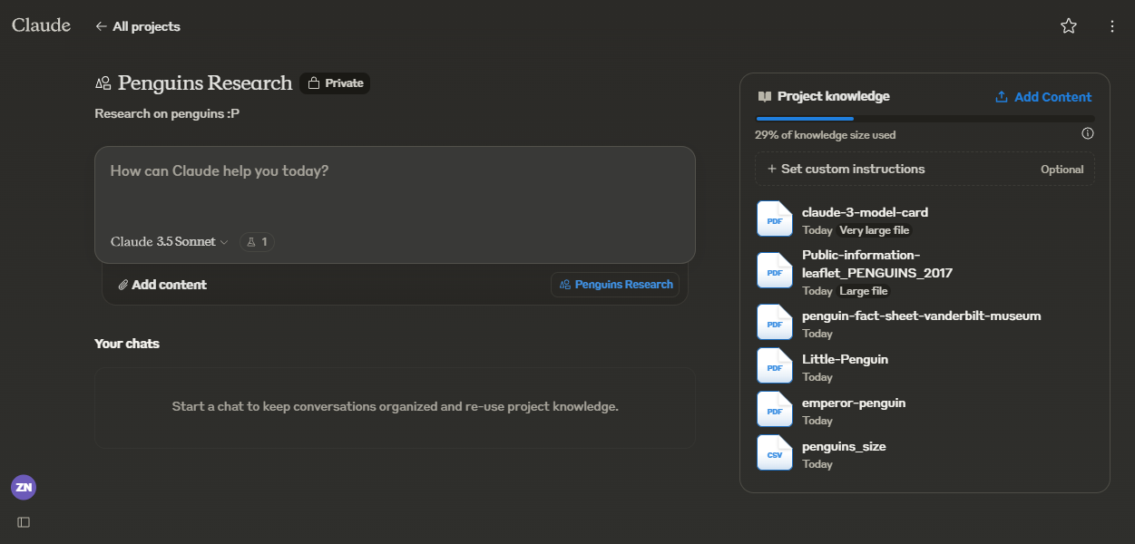
Projects

Slide 4
